Slide 1
Deep Survival Analysis
Alex Tamkin
Alex Martinez
Pol Rosello
Pranav Sriram
Ronjon Naj
Stanford University

Slide 2
Goal of Paper
Given a person's health record, we want to predict whether some medical event will happen within X years
Ex. Coronary heart disease in the next 10 years?
Ex. Death in the next 6 months?

Slide 3
Framework: Survival Analysis
How long until…
…this machine fails?
…that bridge collapses?
…an earthquake hits?
…that couple breaks up?

Slide 4
Framework: Survival Analysis
Survival function S(t)
probability of surviving up to time t
Want to also factor in covariates
i.e. how does this change with gender, age, BMI, etc

Slide 5
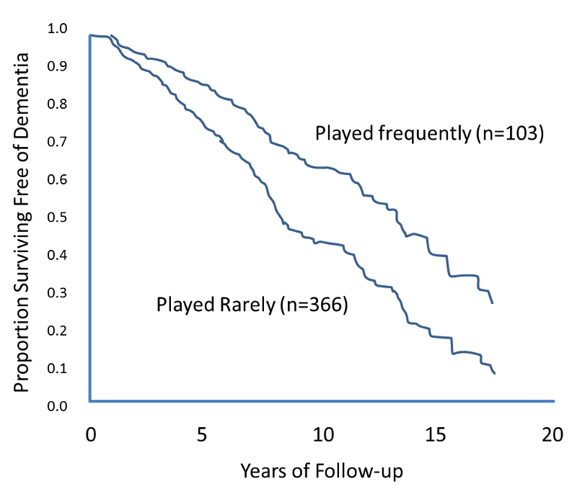
Framework: Survival Analysis
Notes:
Kaplan-meier plot, board games

Slide 6
Why not use vanilla linear regression?
Survival times are positive
Most importantly, two types of observations
Exact: event occurred exactly at time t
Censored: event happened after time t, if at all
Why censored?
Ex. 20-year study on heart attacks, not everyone died
Ex. Someone dropped out of the study
Need to make use of these data

Slide 7
What type of data are we dealing with?
EHR data: Electronic Health Records
Medical history, vitals, diagnoses, medications, immunizations, allergies, test results, etc.
Time-series data

Slide 8
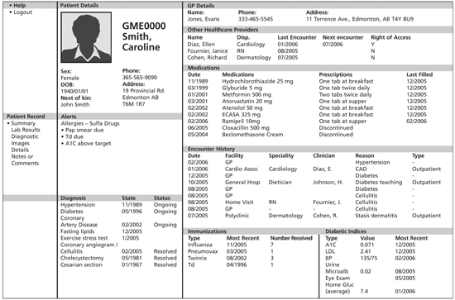
What type of data are we dealing with?
Notes:
Medical history, diagnoses, medications, immunizations, allergies, test results, etc.

Slide 9
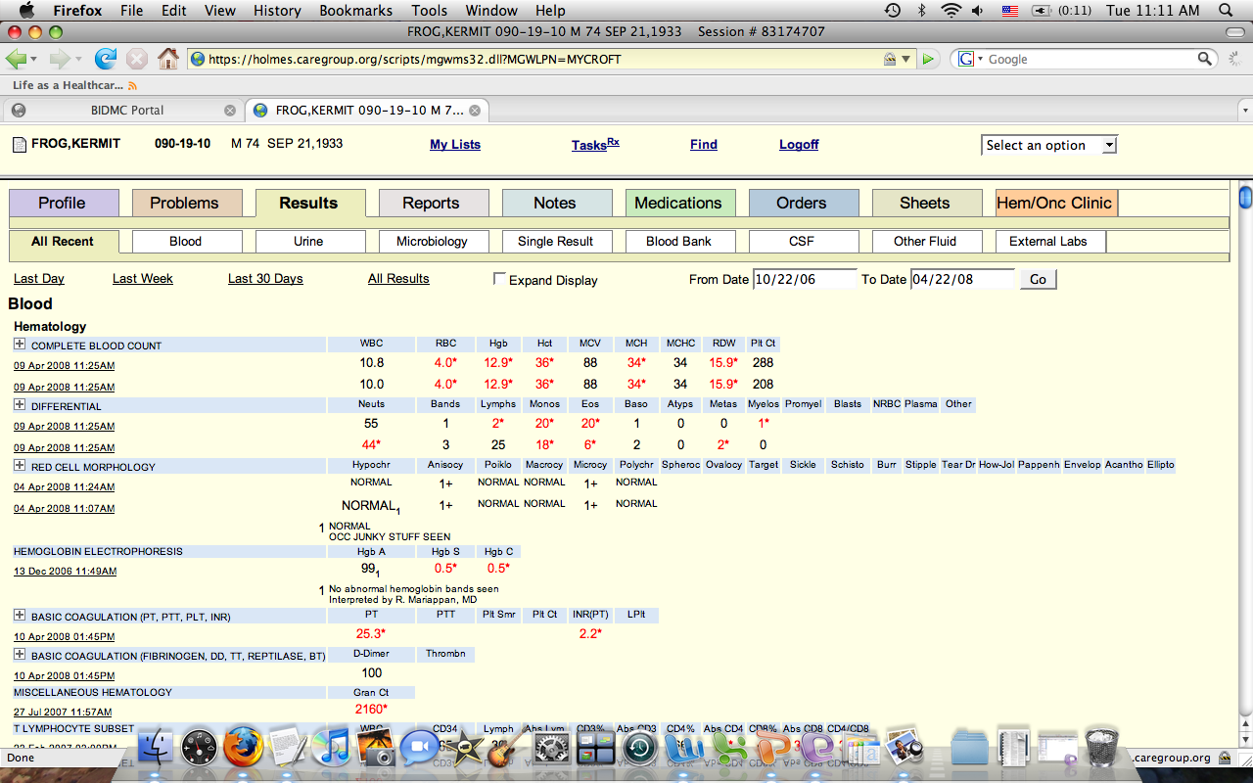
What type of data are we dealing with?
Notes:
Medical history, diagnoses, medications, immunizations, allergies, test results, etc.

Slide 10
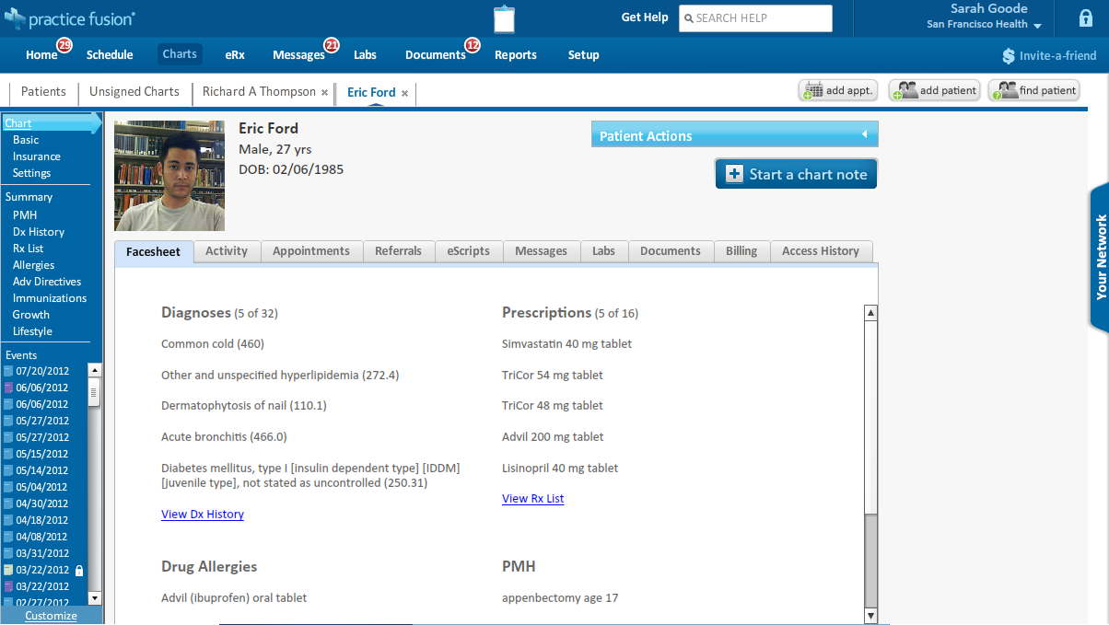
What type of data are we dealing with?
Notes:
Medical history, diagnoses, medications, immunizations, allergies, test results, etc.

Slide 11
Challenges doing SA on EHR data
Data sources measure different information
Have to pick subset of features present in most sources
Same diseases with different names / abbreviations
"Diabetes"
"Diabetes mellitus, type I [insulin dependent type] [IDDM] [juvenile type]"
Binning + bin sizes
Granularity-density tradeoff

Slide 12
Challenges doing SA on EHR data
Missing covariates
E.g. what happens when you skip a checkup? Or you or your doctor aren't taking routine measurements?
Massive problem: only 12% of patients in dataset had a single month where LDL level, HDL level, and blood pressure were all recorded.

Slide 13
Challenges doing SA on EHR data
Traditional SA has a common start point
With studies, can align by entry into trial
With bridge collapse, can align with construction date
With medication, can align with initial dose
Can't do this with EHR data

Slide 14
Challenges doing SA on EHR data
Assumption of linearity between covariates and outcome
As we know, we can do a lot better by introducing nonlinearity!

Slide 15
Variational Inference in Deep Generative Latent Variable Models: An Overview

Slide 16
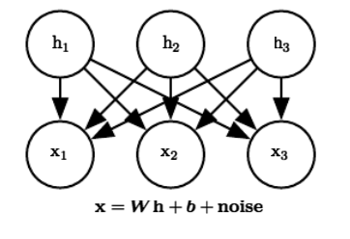
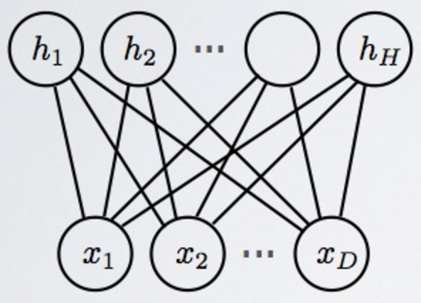
Latent Variable Models
Have a model with three types of variables
Visible variables v, latent variables h, and parameters θ
Examples: Factor Analysis and Restricted Boltzmann Machines

Slide 17
Generative Models: MLE
Maximum Likelihood Estimation
Objective function: maximize log p(v; θ)
p(v; θ) = Σ p(v, h; θ) → Intractable!
Difficulty stems from the fact that p is very complex, therefore hard to sample from
In particular, difficult to compute p(h|v) (inference) due to “explaining away”

Slide 18
Variational Inference: Key Ideas
Performing inference in complicated probabilistic models may be intractable
Replace target distribution with an approximation
Formulate inference problem as optimization problem

Slide 19
The Evidence Lower Bound
p(h|v) is intractable. So consider a new distribution q(h|v)
Define L(v, θ, q) = log p(v; θ) - KL(q(h|v), p(h|v; θ))
KL(q(h|v), p(h|v)) = E_{h~q} [log q(h|v) – log p(h|v)] = - H(q) - E_{h~q} [log p(h|v)]
Kullback-Leibler divergence is always nonnegative
L(v, θ, q) is called the Evidence Lower Bound (ELBO)

Slide 20
What’s so special about the ELBO?
With some algebraic manipulation, ELBO can be rewritten as E_{h~q} p(v, h) + H(q)
Expectation is now with respect to q - can be made tractable!
Recall that ELBO is a lower bound on log likelihood
If q is too simple, bound is too loose. If q is too complex, ELBO is intractable.

Slide 21
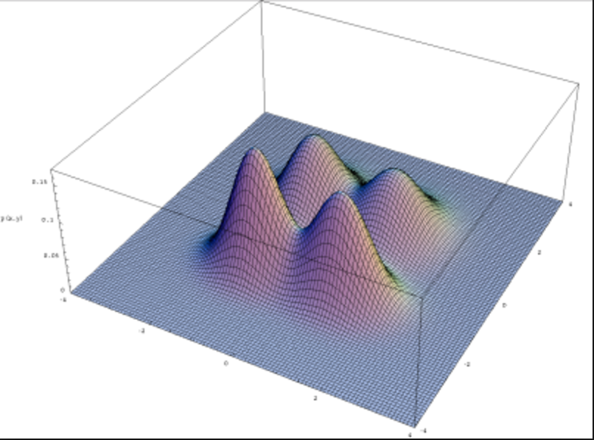
Mean Field Approximation
q(h|v) = q(h₁|v)q(h₂|v)…q(h_{k}|v)
No other assumptions on q (e.g. Gaussian, Bernoulli).
Allows q to be multimodal

Slide 22
From inference to optimization
Instead of maximum likelihood, we seek to maximize the ELBO L(v, θ, q) subject to constraints
Can use EM-style algorithm where we alternatingly update q and θ
Other algorithms use iterative fixed-point equations using partial derivatives with respect to θ

Slide 23
Deep Survival Analysis Model

Slide 24
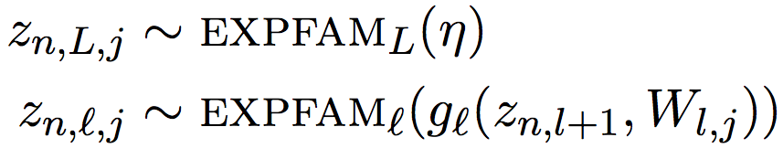
Deep Exponential Families
Typically, missing covariates are usually imputed using population level statistics.
All observations, including covariates, are modeled jointly, with survival times, and conditioned on a rich latent structure.
In deep exponential families, each observation has L layers of latent variables, with each conditioned on the previous layer as below:
Our shorthand for this will be z_{n} ∼ DEF(W)
Notes:
Begin with issue of alignment
Traditionally begin with common origin
Variation in which EHRs begin can cause error.
Patients share defining charateristics at this point.

Slide 25
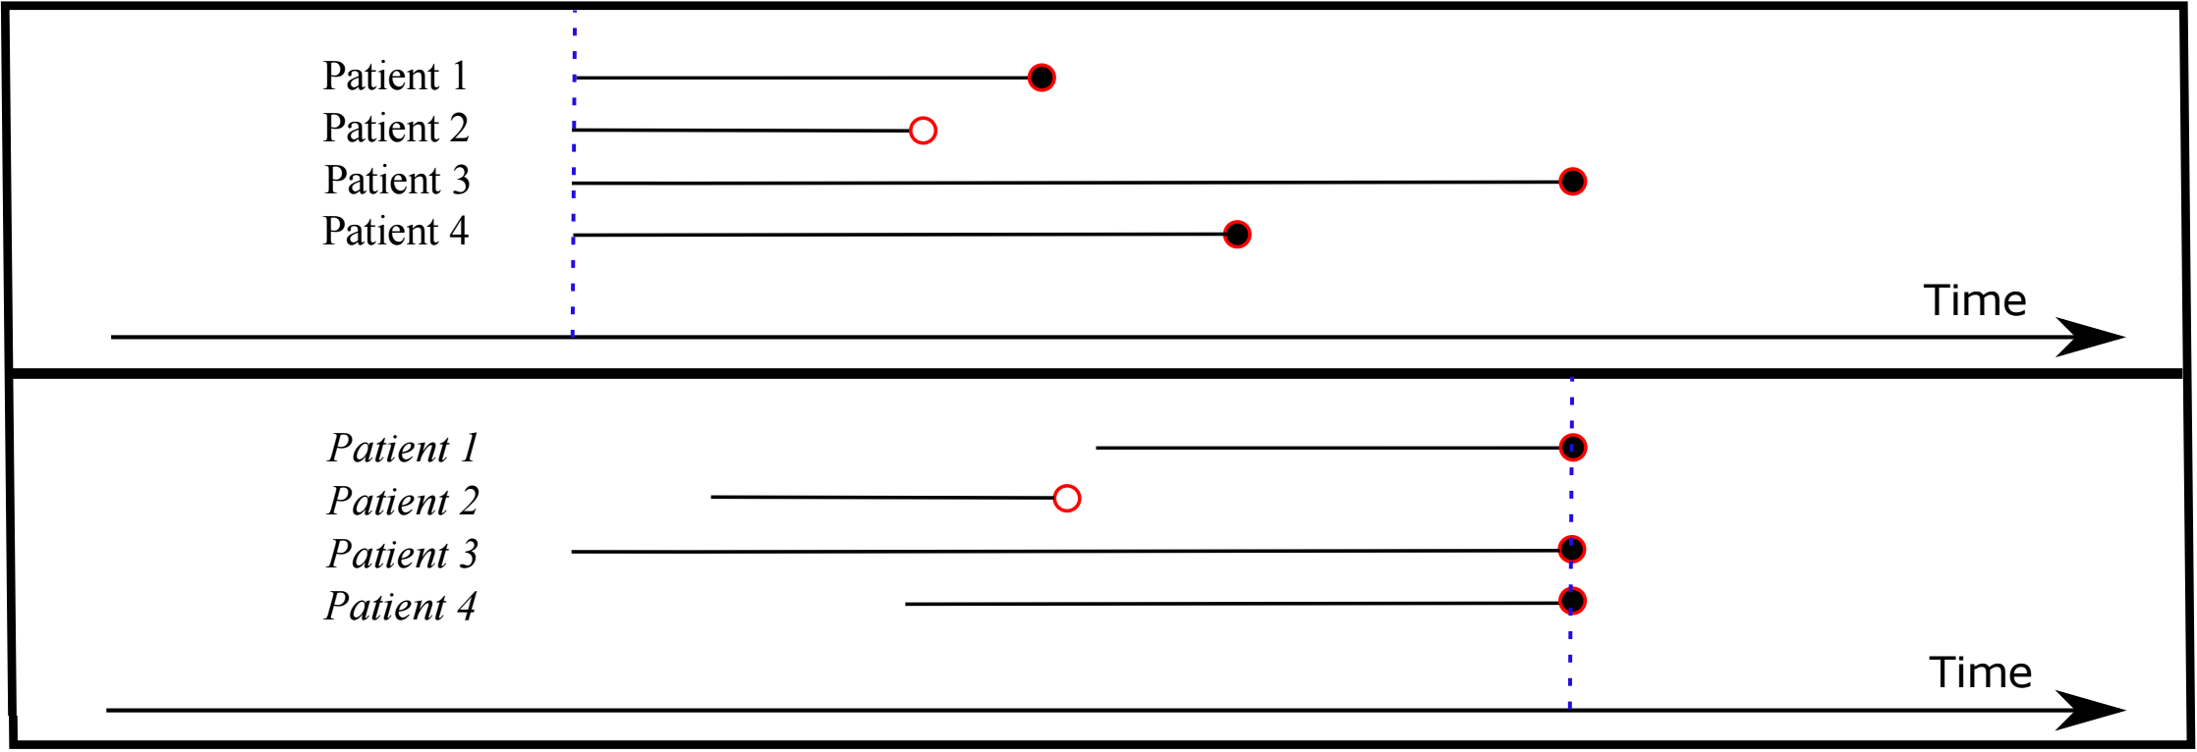
Alignment by Failure
Traditionally, the time t is measured from a common start point (e.g. birth)
This paper uses event-centric ordering instead, handling censored observations as interval observations.
Notes:
Begin with issue of alignment
Traditionally begin with common origin
Variation in which EHRs begin can cause error.
Patients share defining charateristics at this point.

Slide 26
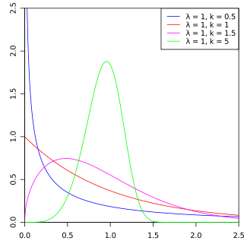
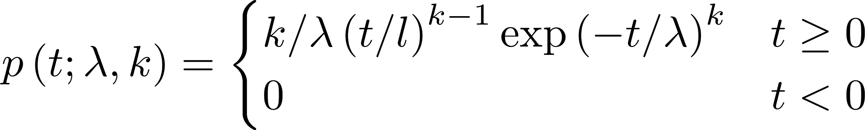


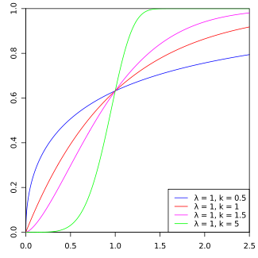

Alignment by Failure
To model time from the event, we use the “popular” Weibull Distribution:
is a scaling parameter, while k parameterizes shape. When k<1, mass concentrates around 0; when k>1, mass concentrates around the expectation .
The likelihood of the Weibull function is thus 1-CDF(x) i.e. .
PDF
CDF
Notes:
The Weibull distribution can also model hazard functions that are decreasing, increasing or constant, allowing it to describe any phase of an item’s lifetime.

Slide 27
Generative Process for Deep Survival Analysis
Let x denote the set of covariates, β be the parameters for the data with some prior p(β), k be a fixed scalar, and let n index an observation
b ~ Normal(0, σ_{b})
a ∼ Normal(0, σ_{W} )
z_{n} ∼ DEF(W)
x_{n} ∼ p(· |β, z_{n})
t_{n} ∼ Weibull(λ=log(1 + exp(z^{T}_{n} a + b)), k)
Covariates from DEF are used to make predictions of x_{n} via the posterior predictive distribution.
We assume data types, both real valued and count, are generated independently conditioned on the hidden state:
Notes:
Softplus maps reals to 0,infty range of the weibull function

Slide 28
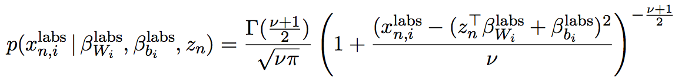
Generative Process for Deep Survival Analysis
Real Valued Observations
We use the student-t distribution to handle data entry error and inhomogeneity given a degree of freedom ν:
Count Valued Observations
To handle sparse, high-dimensional count observations, count values are modeled as binary values, where one represents a non-zero count.
Notes:
We make an assumption that the distribution of real valued observations would reflect a Gaussian. However, the heavy tail and proneness to data-entry errors/variation can cause outliers to warp. Student-t distribution is used instead which you can think of as a gaussian model used when the pop. standard deviation is unknown.

Slide 29
Experiments and Results

Slide 30
Dataset
Experiments and Results
EHR data from 313,000 patients from Columbia University Medical Center
263,000 for training (~84%)
25,000 for validation (~8%)
25,000 for testing (~8%)
Vital signs, laboratory test measurements, medication orders, and diagnosis codes
Measurements discretized and aggregated for each month
Try to predict coronary heart disease (CHD)

Slide 31
Model Setup and Hyperparameters
Experiments and Results
Weibull k = 2 (shape): failure rate increases with time
Gaussian exponential family for DEF
2-layer neural networks with ReLU activations for the softplus variance functions
Normal priors set to μ = 0, 𝜎² = 1
RMSProp
6,000 iterations, assessing convergence on the validation set
40-core Xeon Server with 384 GB of RAM
7.5 hours
Inference using mean-field family
Hyperparameter choices not motivated

Slide 32
Baseline and Evaluation
Experiments and Results
Framingham CHD risk score (Wilson et al. 1998)
Takes into consideration age, sex, LDL cholesterol, HDL cholesterol, blood pressure, diabetes, and smoking
Shown to have good predictive power of 10-year risk with a concordance of 0.73 for men and 0.77 for women on curated data.
Lower performance when applied to EHR data
Only 11.8% of patients have at least one month in their record where LDL, HDL, and blood pressure were all measured.
Evaluate performance against baseline, varying the dimensionality K of z_{n} (and the layer size of the networks).

Slide 33
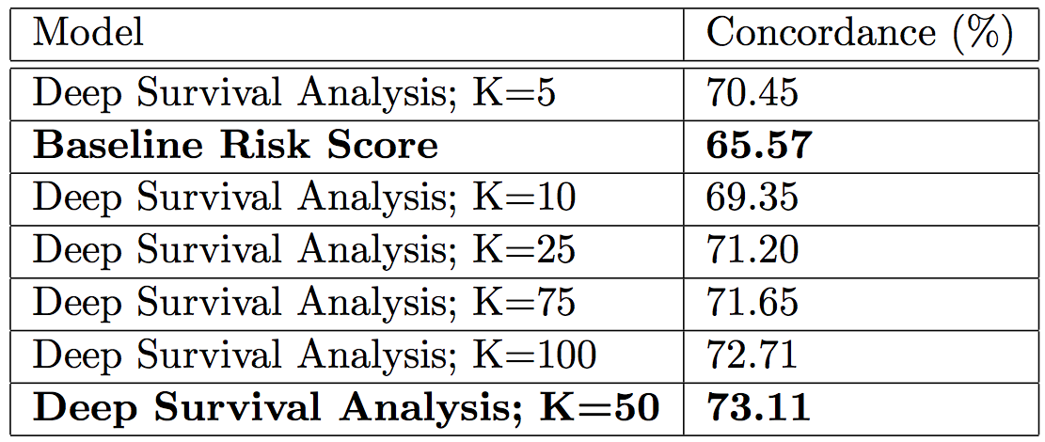
Results
Experiments and Results
Concordance on test set (Harrell et al., 1982)
Fraction of pairs of observations where the model correctly predicts the observation with the higher survival time

Slide 34
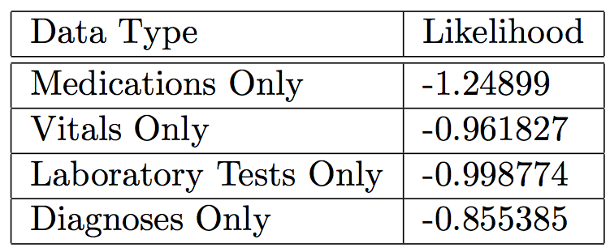
Results
Experiments and Results
Predictive likelihood of deep survival model (K=50)

Slide 35
Discussion

Slide 36
Contributions
Improves performance over Framingham CHD risk score
First application of deep exponential families to survival analysis
Scalably handles heterogeneity in EHR data
Promising for developing risk scores from observational data for conditions where there is no known risk score

Slide 37
Weaknesses
Network architecture choice
Fully-connected, only 1 hidden layer
No discussion or comparisons
No hyperparameter optimizations
No regularization
Technical choices glossed over or not explained
Variational inference
Concordance metric
Reasons for specific exponential family choices

Slide 38
Sources
https://www.cscu.cornell.edu/news/statnews/stnews78.pdf
https://www.healthit.gov/providers-professionals/faqs/what-electronic-health-record-ehr
https://arxiv.org/pdf/1608.02158v1.pdf
http://www.deeplearningbook.org/contents/inference.html
https://ocw.mit.edu/courses/electrical-engineering-and-computer-science/6-438-algorithms-for-inference-fall-2014/lecture-notes/MIT6_438F14_Lec17.pdf

